Slide 1
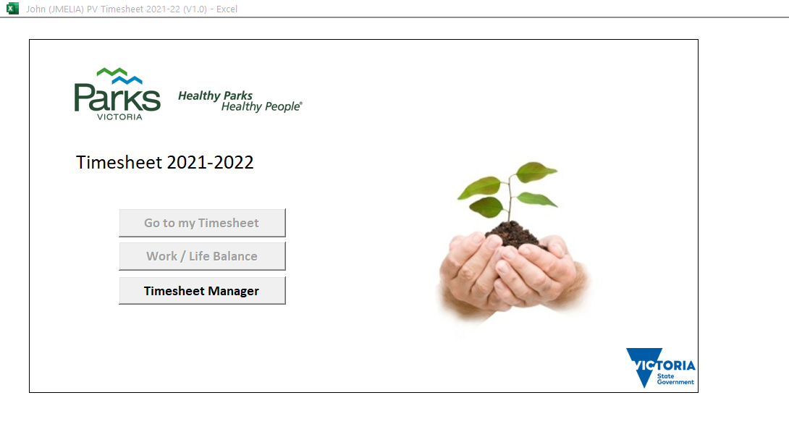
Parks Victoria Timesheet 2022-23

Slide 2
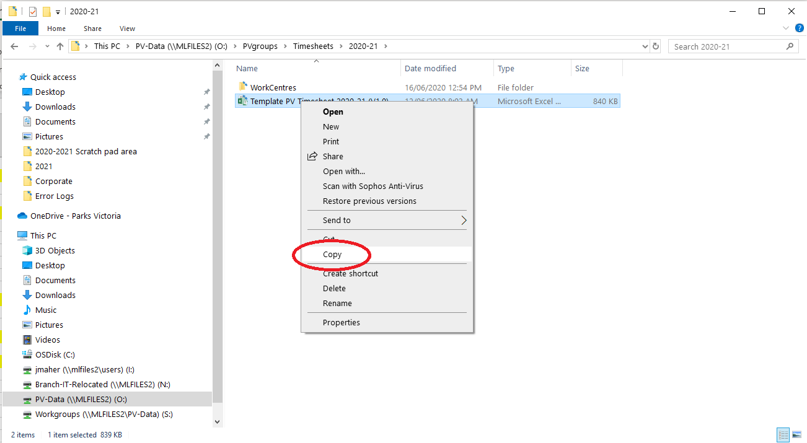
Parks Victoria Timesheet 2022-23
You will find the template here: O:\PVGroups\Timesheets\2022-23
The first step is to take a copy to your groups folder
Copy the Template file

Slide 3
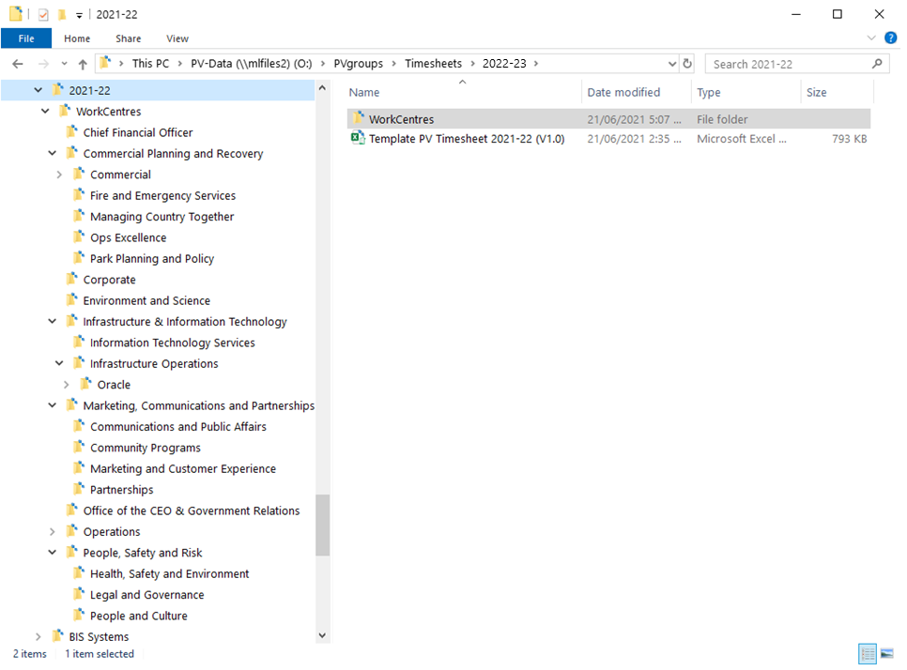
Parks Victoria Timesheet 2022-23
Where you paste it depends on your Business Unit’s folder

Slide 4
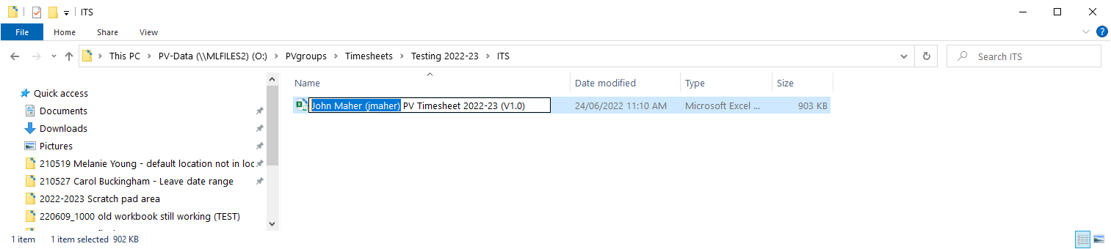
Parks Victoria Timesheet 2022-23
Rename your timesheet for easy identification,
then open your timesheet.

Slide 5
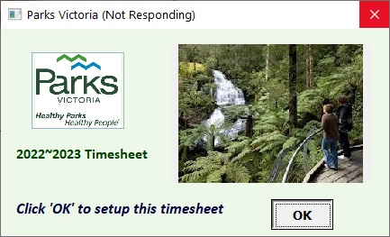
Parks Victoria Timesheet 2022-23
Setting up your Timesheet
A timesheet which has not been setup, will display this welcome screen.
Click the ‘OK’ button to begin the setup process
NOTE: You must be connected to the Parks Victoria Network to setup your timesheet

Slide 6
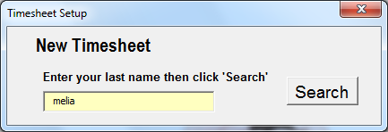
Parks Victoria Timesheet 2022-23
Setting up your Timesheet
Enter all or part of your last name….
… then click “Search’

Slide 7
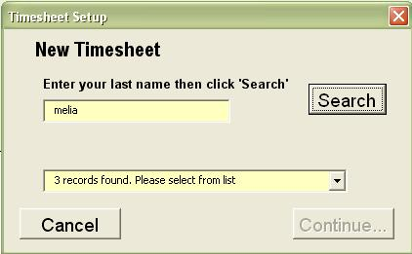
Parks Victoria Timesheet 2022-23
Setting up your Timesheet
The form will indicate the number of records found.

Slide 8
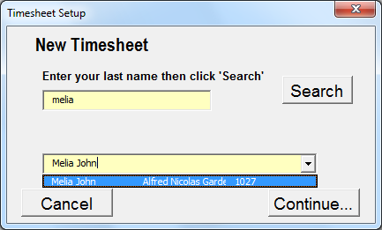
Parks Victoria Timesheet 2022-23
Setting up your Timesheet
The PV Oracle database is queried and returns a list of names, work centres and employee ID numbers.
Click the ‘Down Arrow’ and select your name from the list

Slide 9
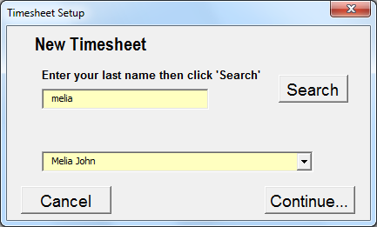
Parks Victoria Timesheet 2022-23
Setting up your Timesheet
Then click ‘Continue..’

Slide 10
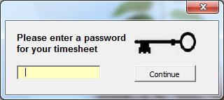
Parks Victoria Timesheet 2022-23
Setting up your Timesheet
You will be asked to enter a password for your timesheet…

Slide 11
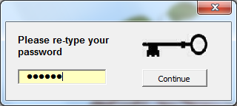
Parks Victoria Timesheet 2022-23
Setting up your Timesheet
… then you will need to re-type your password.

Slide 12
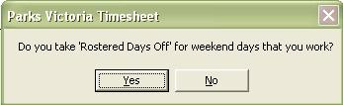
Parks Victoria Timesheet 2022-23
Setting up your Timesheet
If you are a part-time rostered employee, you will be asked if you take Rostered Days Off (RDOs) for weekend days worked.
Answer ‘Yes’ if you do take Rostered Days Off.
(NOTE: Most staff do take RDOs, although some part-time staff fill in a variance to pay and are paid rather than taking a RDO)

Slide 13
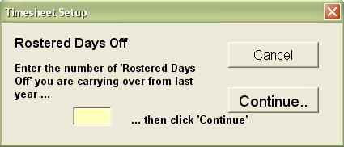
Parks Victoria Timesheet 2022-23
Setting up your Timesheet
If you are a rostered weekend employee, you will be asked to enter the number of Rostered Days Off you had not used as of July 1st 2020.
Enter the number of RDOs you had not used when you finished your 2019-20 timesheet…
… then click ‘Continue..’
Check with your supervisor if you are not sure.

Slide 14
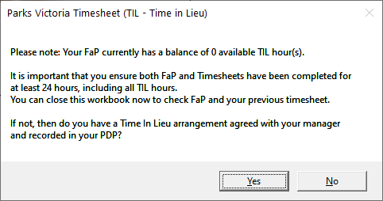
Parks Victoria Timesheet 2022-23
Setting up your Timesheet
…next you will be asked if you accrue TIL when you work more than your normal or paid work hours on any day.
If you have an agreed TIL plan with your supervisor, select ‘Yes’ otherwise select ‘No’.
Check with your supervisor if you are not sure. You must apply for your TIL balance in FaP.

Slide 15
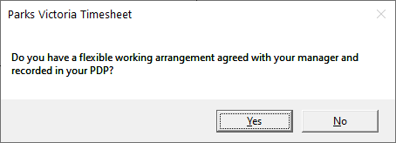
Parks Victoria Timesheet 2022-23
Setting up your Timesheet
…next you will be asked if you accrue Flexi hours when you work more than your normal or paid work hours on any day.
If you have an agreed Flexi Time plan (including a flexible work arrangement) with your supervisor, select ‘Yes’ otherwise select ‘No’.
Check with your supervisor if you are not sure. You must apply for your TIL balance in FaP.

Slide 16
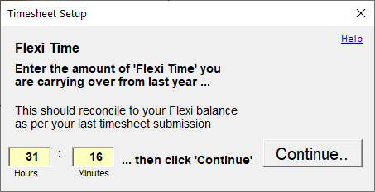
Parks Victoria Timesheet 2022-23
Setting up your Timesheet
Please check your June timesheet and use the Flexi balance from this month.
Enter the balance as your Flexi Time balance for the new timesheet
Accrued Time means more than just TIL, and includes flexible work arrangements.

Slide 17
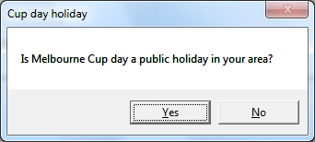
Parks Victoria Timesheet 2022-23
Setting up your Timesheet
The date of the cup holiday varies across the state.
If your location follows the Melbourne Cup, then click Yes
Click here for Victorian non-metropolitan public holidays 2020

Slide 18
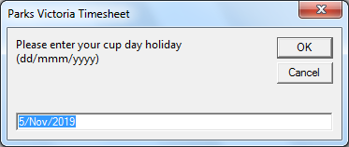
Parks Victoria Timesheet 2022-23
Setting up your Timesheet
If you clicked No, you will be asked for the date of your cup holiday.
This date can be changed afterward using the ‘Timesheet Manager’. It will be displayed on the ‘My Information’ screen.

Slide 19
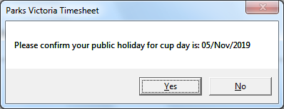
Parks Victoria Timesheet 2022-23
Setting up your Timesheet
Then, click Yes to confirm the date you entered
This date can be changed afterward using the ‘Timesheet Manager’. It will be displayed on the ‘My Information’ screen.

Slide 20
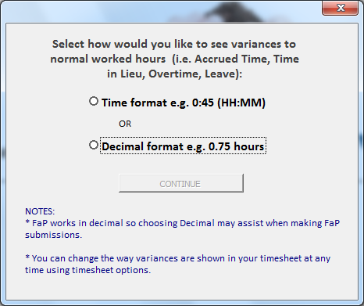
Parks Victoria Timesheet 2022-23
Setting up your Timesheet
The Timesheet allows two presentation formats.
You can change your selection in the ‘Timesheet Display Options’ under ‘More Options’

Slide 21
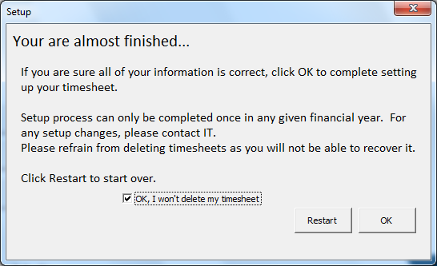
Parks Victoria Timesheet 2022-23
Setting up your Timesheet
Read through and confirm your acknowledgment by marking the checkbox.
Click ‘OK’ to continue

Slide 22
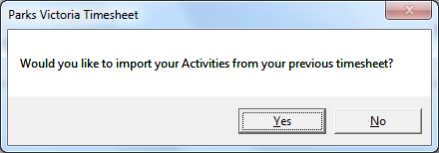
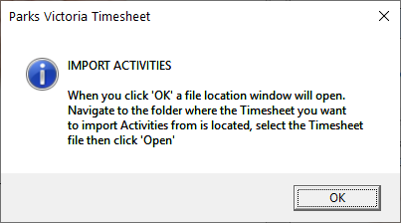
Parks Victoria Timesheet 2022-23
Setting up your Timesheet
If you have used timesheets previously you can import your activities from your old timesheet.
Click ‘Yes’ and ‘OK’ to continue

Slide 23
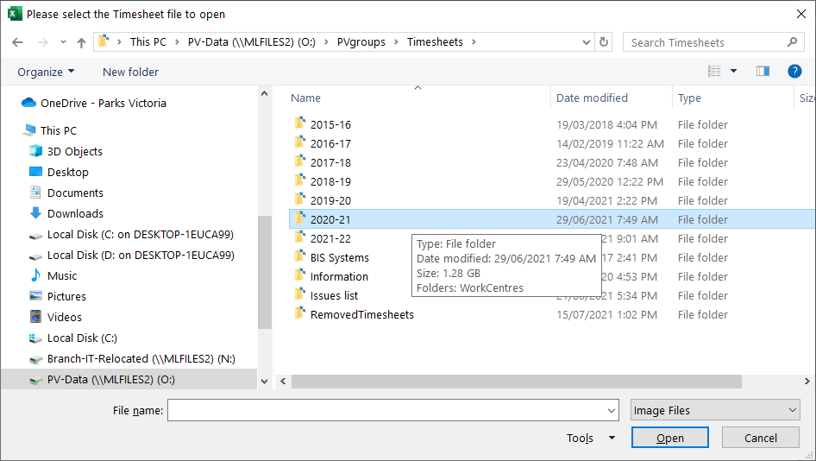
Parks Victoria Timesheet 2022-23
Setting up your Timesheet
Navigate to last years folder and find your old timesheet in your business units old directory
Alternatively you can select a colleagues timesheet to import. Ensure that their role is similar to your own.
Click ‘Open’ to continue

Slide 24
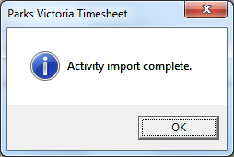
Parks Victoria Timesheet 2022-23
Setting up your Timesheet
You can still add your own activities.
Click ‘OK’ to continue

Slide 25
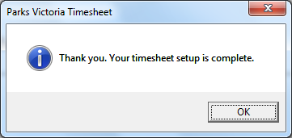
Parks Victoria Timesheet 2022-23
Setting up your Timesheet
Your timesheet is now set up….
Wait for the timesheet to save
…click ‘OK’ to finish.
.

